Slide 1
Generalized Die Hard Problem
易星辰
2018.03.30

Slide 2
Die Hard Problem
问题描述
工具：水源、两个无刻度容量分别为3和5加仑的壶
目标：精确得到4加仑的水
模型建立
变量：small，big(代表两个壶中的水量)
初始状态：两个壶均为空
状态转换关系：清空壶、倒满壶、转移壶中水量

Slide 3
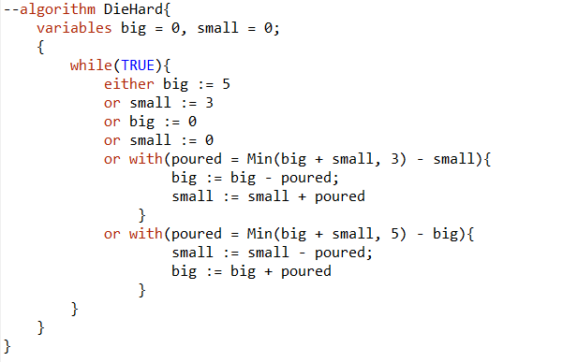
TLA+

Slide 4
Generalized Die Hard Problem
问题描述
工具：水源、任意个无刻度水壶
目标：精确获得给定值的水量
模型建立
变量：Jugs，Goal，Capacity(Jugs → Nat / {0})
初始状态：所有水壶均为空
状态转换关系：清空壶、装满壶、转移壶中水量

Slide 5
Function in TLA+
数学定义
集合A、B，f：A → B
TLA+
Jugs → Nat
Specific Function f
定义域: {d1, … ,dn}
TLA+描述: (d1 :> f[d1] @@ … @@ dn :> f[dn])
<-6, -5, -4>: [i \in 1.. 3 |-> i - 7]
<“a”, “b”, “c”>: (1 :> “a” @@ 2 :> “b” @@ 3 :> “c”)

Slide 6
动作抽象
Full jug j
with (j \in Jugs) {
injug[j] := Capacity[j]
}
Empty jug j
with(j \in Jugs){
injug[j] := 0
}
Pour from jug j to jug k
with(j \in Jugs, k \in Jugs \ {j}){
with(poured =
Min(injug[j] + injug[k], Capacity) - injug[k]){
injug[j] := injug[j] – poured;
injug[k] := injug[k] + poured
}
}

Slide 7
Two Additional rules in PlusCal
Rules:
Two separate assignment statements that assign to the same variable cannot occur within a single step
The body of a with statement cannot contain a label.
错误
with(poured =
Min(injug[j] + injug[k], Capacity) - injug[k]){
injug[j] := injug[j] – poured;
injug[k] := injug[k] + poured //error
}
修改
injug[j] := injug[j] − poured || injug[k] := injug[k] + poured

Slide 8
Check the Algorithm
Check Invariant
∀ j \in Jugs : injug[j] /= Goal

Slide 9
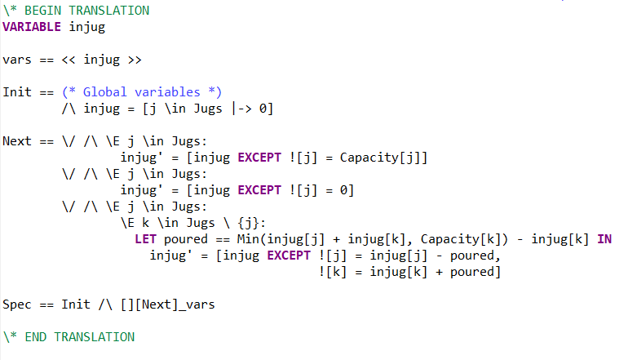
The TLA+ Translation
injug[j] := Capacity[j]
if i == j THEN injug[i] = Capacity[i] ELSE injug[i] = injug[i]

Slide 10
Q&A

